Slide 1
Local Health and Human Service Agencies
Student’s Name
University Department
Course Name/Number
Professor’s Name
Date

Slide 2
1. Planned Parenthood (PP)
Purpose
Provides telehealth services on reproductive issues such as:
-Testing and treatments of STDs
-Birth control services
-Abortion services
-Emergency health services
Target population
-Female adults within the age of procreation and anyone seeking reproductive health services
Notes:
Planned Parenthood is a health agency that provides reproduction support for planned parenthood not only in New York City but across the country. The services offered have been included in this slide with the main targeted population being female adults within the age of reproduction. Through the telehealth services, the agency is able to reach to wider population outside the New York City.

Slide 3
Continuation of P.P
Impact on Community
1. Improved reproductive health care
2. Sex education and awareness
3. Informed community through education
Contact Information
Address: 123 William Street, 10th Floor, NY
Tel: 1-800-230
Website: https://www.plannedparenthood.org/
Relates to hormones and reproductive health concepts learned in class
This involves the importance of regular check-ups
The need to consider prenatal nutrition in prenatal care
Notes:
Planned Parenthood is a website that have significantly impacted the community in various ways. I have listed some of the impacts including improved reproductive health care in the community as the agency deals with reproductive problems or issues that many people face in the community. The contact information has also been provided. In relation to the course text, this agency’s purpose is related to the hormones and reproductive health concepts we learned in the text.

Slide 4
2. Pride for Youth (PFY)
Purpose
The agency advocates for lesbians, gay, bisexual, transgender, and queer young people through age 30
Target Population: Young people up to the age of 45 years
Impact on Community
1. Enhanced wellness and health of LGBTQ people
2. Improved cultural competency among this group
3. Youth development and support to this group members
4. Improved awareness through education
Notes:
Pride for Youth (PFY) is a service agency that advocates for the rights of LGBTQ young people up to the age of 45 years. This agency has impacted the community by increasing awareness and teaching the community of the need to accept the diversity of sexuality of every member of the group. Furthermore, through the youth development programs and services, the agency has been able to empower the youths of this group of LGBTQ. The target population as mentioned in this slide comprises of young people belonging to the LGBTQ up to the age of 45 years.

Slide 5
Continuation of PFY
Contact
Agency is located in New York’s Nassau, Suffolk, and Queens Counties
Address: 628 Long Island Ave, Deer Park, NY 11729-4043
Tel: (631) 940-1964
Website: https://longislandcrisiscenter.org/prideforyouth/
Relation to the text
PFY’s purpose relates to chapter two about stress and three about psychological health of LGBTQ group
LGBTQ faces stress and psychological discomfort associated with stigmatization of their sexual orientation
Notes:
PFY is an agency that advocates for the young people with sexual orientation issues ranging from gay to lesbianism. I have given the contact address for the agency, which is located in Long Island, New York. In relation to the course text, this agency’s purpose is related to the concepts of stress in chapter two and psychological health discussed in chapter three.

Slide 6
3. LiveOnNY
Purpose
Assists New Yorkers to live on through organ and tissue donations and procurement
Also, cares for the families of the organ donors
Target Population- All New Yorkers who wish to donate their organs or tissues
Impact on Community
1. Educated community about power of donations
2. Saves life of those who need organ donation
Protects the interests of those who have donated organs
Notes:
As health problems continue to affect many people, organizations like LiveOnNY have come in to assist people by procuring organs and tissues that they need to continue living on. There is no specific target group, but the agency focuses on the all New York state citizens, both who wish to donate organs and tissues as well as those who need the organs and tissues. The impact to the community is immense as listed in this slide. For example, the agency has enhanced awareness about the power to donate by teaching the community on the need to help others to continue living.

Slide 7
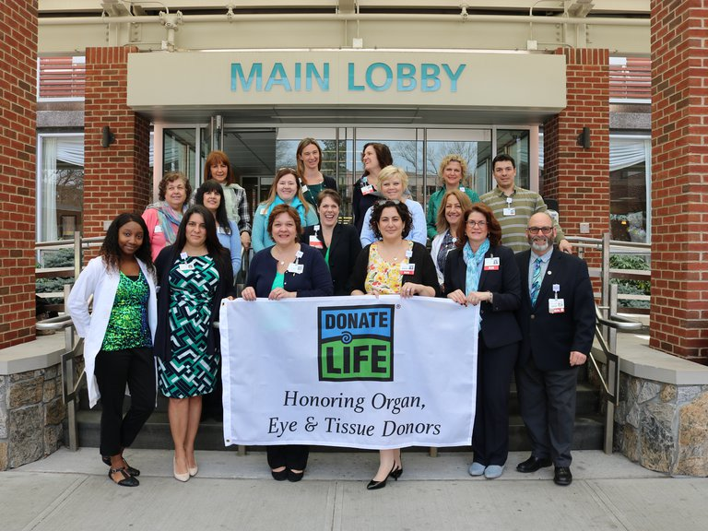
Continuation of LiveOnNY
Contact
Address: 460 West 34th. St, 15th Floor
New York, NY 10001
Tel: 646-291-4444
Website: https://www.liveonny.org/
Relation to the text
This agency’s purpose is related to the concept of cardiovascular health and cancer health issues in chapter 13 of the text- People with cardiovascular diseases require proper and specialized care
It also related to the concept of challenge of aging where the elderly requires care and social services
Notes:
This slide has given the contact information of the LiveOnNY agency. As a private and nonprofit organization, LiveOnNY provides many people with the opportunity to continue living through procurement of organs and tissues that can facilitate their continuance of life. In relation to the course text, this agency’s purpose is related to the cardiovascular issues discussed in chapter 13 of the text. Furthermore, it also relates to challenge of aging in chapter 18. Old people are prone to diseases that may cause organ failure. Through organ donations, LiveOnNY continue to give these people a chance to be with their loved ones.

Slide 8
4. Maurer Foundation
Purpose
Save lives through breast health education
The agency focuses on breast cancer, healthy lifestyle choices, and early detection and risk reduction
Target Population: Young women and female students
Impact on Community
1. Enhanced awareness through education
2. Improved community health through healthy lifestyle programs
3. Reduced cases of breast cancer through early detection
Notes:
Breast cancer is becoming a major health concern among the youths and young women. Maurer Foundation was started in 1995 with the aim of reducing breast cancer fatalities through advocating for early detection and risk reduction. Also, through breast health education programs, the agency has managed to caution people on preventive measures which include healthy lifestyle.

Slide 9
Continuation of Maurer Foundation
Contact
Located in Nassau County, New York
Address: 90 Broadhollow Road, Suite 401E
Tel: 631.524.5151
Website: https://www.maurerfoundation.org/
Relation to text
It relates to chapter concept of taking charge of individual’s health
Also, it relates to chapter ten, nutritional basics-dietary guidelines and eating habits influence one’s health
As well as chapter 13 on cardiovascular health and cancer-cancer is related to individual’s lifestyle
Notes:
This agency deals with many issues discussed in the course text. For instance, in chapter one, taking charge of one’s health, the author discusses how personal health behavior can affect or influence an individual’s wellness. As such, Maurer Foundation’s purpose is in line with this chapter as it advocates for healthy lifestyle and behavior that can reduce the risk of getting breast cancer.

Slide 10
5. Family & Children Association (FCA)
Purpose
Provides services which include:
-Children’s mental health and wellness
-Addiction prevention, treatment, and recovery
-Residential care
-Senior & Adult services
Impact on Community
1. Helped in eradication of addiction problems
2. Impacts greater sense of responsibility to
Helps in taking care of the elderly in the community
Notes:
No one wishes to be left alone to struggle after retirement. Also, no one wishes to be a burden to others. As such, FCA has been helping the community in Mineola County deal with the social service problems including taking care of the elderly as well as impacting sense of responsibility in the members of the community. Also, through the rehabilitation services, FCA has been able to assist many people end their addiction problems. The agency has also been providing mental health services for children in Mineola.

Slide 11

Continuation of FCA
Contact
Located in Mineola, New York
Address: 100 E. Old Country Road
Mineola, NY 11501
Tel: (516) 746-0350
Website: https://fcali.org/#!
Relation to text
The agency’s purpose is related to:
1. Chapter one: psychological disorders in families- people with substance abuse disorder are prone to psychological problems.
Impacts of substance use disorder can help promote mental wellness
Notes:
Families are struggling with many issues ranging from addiction to drugs and alcohol to neglect that may cause psychological disorders, especially among young children. FCA provides families with counseling services for those with addiction problems as well as mental health services for children. This relates to chapter one and eight of the course text; psychological disorders and drug use and addiction respectively. This improves the sense of responsibility in families.

Slide 12
6. EPIC Foundation
Purpose
Provides mental health services including
1. Intellectual and developmental disabilities
2. Epilepsy services
3. Mental health clinic
4. Child guidance services
Impact on Community
1. Improved social care services for the elderly in East Meadow
2. Provided innovative ways to manage mental and developmental disabilities among children
Notes:
Every family wants to live with their loved ones for as long as they can. Children with disabilities often find it difficult to relate with other people. Organizations like EPIC have designed programs to help children with mental and developmental challenges experience life just like everyone else in the community. As such, the agency has significantly assisted in improving social care services to the elderly and children with disabilities. Through mental health clinics, EPIC further provides caregivers and parents innovative ways to manage disability conditions.

Slide 13
Continuation of EPIC
Target population- Children and adults with mental health problems
Contact
Located in East Meadow, New York
Address: 1500 Hempstead Turnpike, East Meadow, NY 11554
Tel: +1 516-739-7733
Website: https://www.epicli.org/
Relation to text
Related to chapter 3 on psychological health disorders-Mental health problems is associated with psychological problems
Early detection can help in reducing the psychological impacts
Notes:
Psychological disorders can include anxiety disorders, mood disorders, schizophrenia, and attention-deficit as well as hyperactivity disorders. These disorders discussed in chapter 3 of the text relates to the services that EPIC agency provides. Children are prone to these conditions and that is why EPIC focuses on children’s mental health and wellness through mental health clinics and child guidance centers.

Slide 14
7. Hope for Youth
Purpose
Provides diagnostic and emergency residential services
Clinical and preventive services
Target population: Children and youths through 21 years
Impact on Community
1. Provides shelter for runaway and homeless youths
2. Improved sense of responsibility for community members through character building
3. Improved family-relationships
Notes:
Hope for Youth is an organization that recognizes the challenges that family faces ranging from runway and homeless to the families who need children to love. As such, the agency’s role is to link those who need children with the children who need a home or shelter. This has improved the lives and family relationships of community members. Furthermore, it has also improved sense of responsibility among runways through character development.

Slide 15

Continuation of HFY
Contact
Located in Amityville, New York
Address: 201 Dixon Avenue, Amityville, NY 11701
Tel: (631) 691-5100
Website: https://hfyny.org/
Relation to text
This agency’s purpose is related to:
1. Chapter eight on drug use and abuse- Young people are prone to drug abuse and use.
3. Chapter seventeen on Personal safety- Personal safety involves awareness of the dangers associated with drug use and abuse
Notes:
Every child wishes to stay with a family where they can thrive and grow like a normal child. Hope for Youth provides that opportunity to grow and thrive for children and youths to grow and thrive in a place where they are loved and cared for by their caregivers and guardians. Runaways and the homeless are exposed to drug use and addiction as well as neglect to their personal safety. Hope for Youth seeks to provide the youths and children in Amityville with the opportunity to feel the love of a family and safety.

Slide 16
8. Central Nassau Guidance and Counseling Services
Purpose
Provides guidance and counseling services to mentally ill and substance use disorder
Target population: Youths with mental health and substance use disorder
Impact on Community
1. Increased awareness on mental health disorders
2. Provide social support for mentally ill and people with substance disorders
3. Enhanced parenting skill-building and communication
Notes:
Many people suffer with substance abuse and mental health disorder in silent due to stigmatization associated with such disorders. Central Nassau guidance and counseling service agency provides these people the platform to face their problems as well as give them help they need to recover or skills they need to survive with the condition. This nonprofit organization has been operation in Long Island County since 1972 and has provided residents with social support through guidance and counseling to face their mental health and substance disorder problems.

Slide 17

Continuation of NC
Contact
Located in Hicksville, New York
Address: 950 South Oyster Bay Road
Hicksville, NY 11801
Tel: (516) 822-6111
Website: https://centralnassau.org/
Relation to text
The agency’s purpose is related to:
1. Chapter one on taking charge of one’s health- Adopting a personal health behavior that promote wellness
2. Chapter three on psychological health-Involves dealing with the psychological issues like relapse
Notes:
Many young people suffer with substance use and mental health disorders which affects their general health from psychological to physical health. Therefore, as discussed in chapter one of the text about reaching wellness through lifestyle management, NC agency provides counseling services to help people with substance use disorder and mental health problems to deal with the relapse problem that they face.

